Slide 1
CS2033a/b
Lecture 6
Working with CSS Styles
The Box Model
Vivi Tryphonopoulos

Slide 2
LECTURE #5 OVERVIEW
Understanding:
What is CSS?
What is the Box model
How to use the box model to create a website
Div Ids and Classes
Starting to work with styles
Building a website with CSS

Slide 3

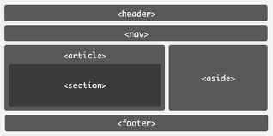
CSS CONCEPTS :
Starting to build a website without tables
Before we used to build a website with Tables...
Using Tables
1st table: 2 rows x 1 col
2nd table: 2 rows x 2 col
Notes:
16px may look great on a desktop monitor, but on a mobile device 16px is huge
If we use 1em , telling device to set font to 100% of its default font size which is one size on the desktop and another size on a mobile device

Slide 4
CSS CONCEPTS :
Starting to build a website without tables
Now build a website
.... the “Developer” way ...
Use CSS Styles
Using Tables
Using CSS Styles
1st table: 2 rows x 1 col
2nd table: 2 rows x 2 col
Identifying box elements and attributes
using DIV IDs and Classess
Notes:
16px may look great on a desktop monitor, but on a mobile device 16px is huge
If we use 1em , telling device to set font to 100% of its default font size which is one size on the desktop and another size on a mobile device

Slide 5

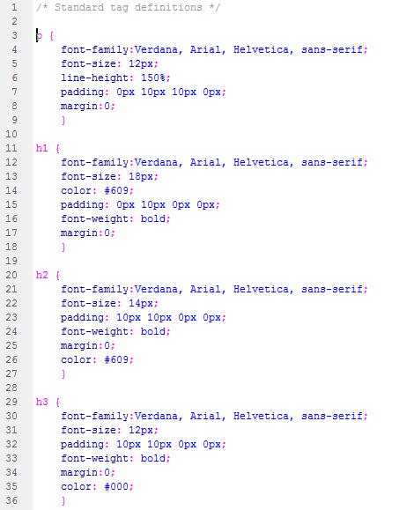
WHAT IS CSS?
Cascading Style Sheets (CSS)
CSS is not a markup language like HTML
or a scripting language like Javascript
CSS is a stylesheet language
Stylesheets are a collection of formatting rules
controls the appearance of HTML webpages
HTML controls the structure
  Add text, image, links, ordered lists
  HTML – you can see the structures
CSS controls the presentation/appearance/style
  Will the text be blue, arial, bolded?
  What size should H1 headings be?
  Will images have a border around them, padding etc.
  Will links be red before visited, blue when visited, brown when hover?
Notes:
EXAM

Slide 6
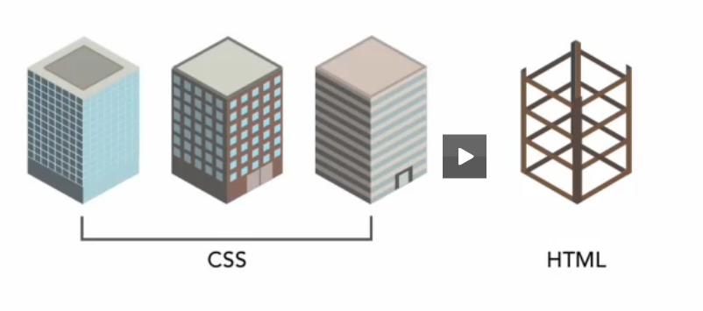
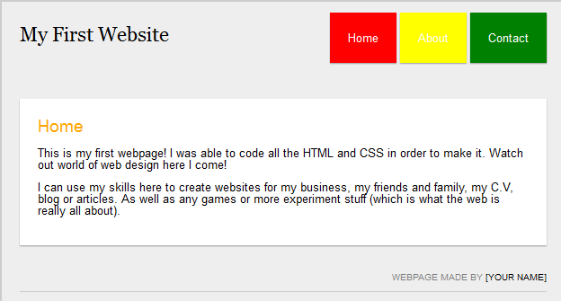
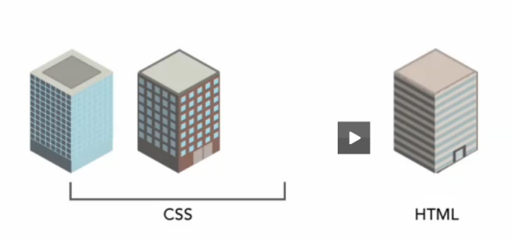
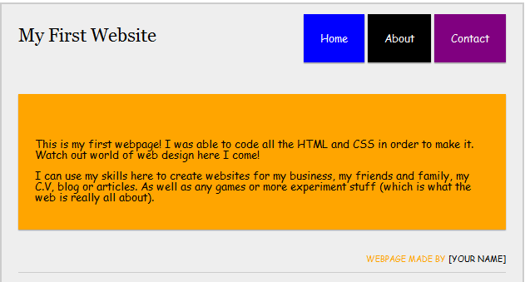
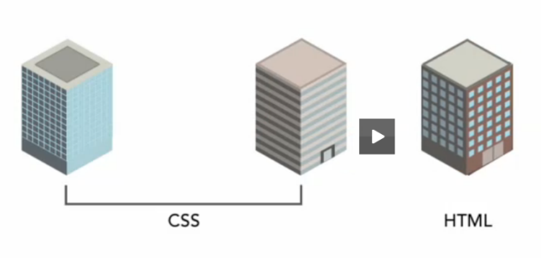
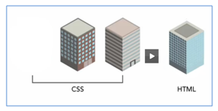
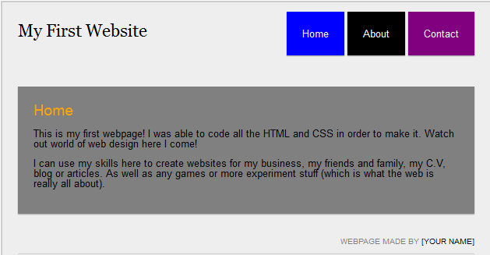
Controlling the Look with CSS
3 different style sheets
→ will give 3 different looks

Slide 7
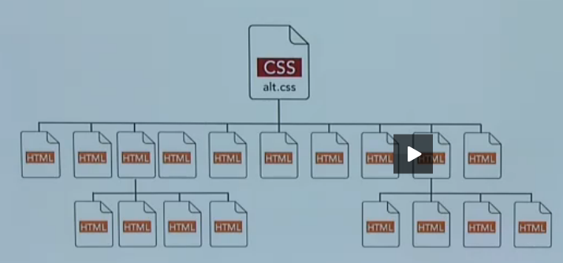
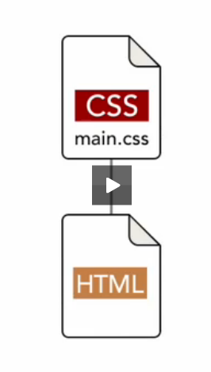
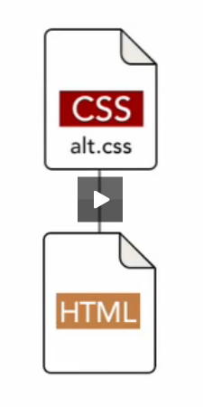
BENEFITS OF CSS?
Using CSS
You can change the entire layout of the page without changing its content or structure
→the HTML code stays the same but the CSS affects the look
One or more styles can be used to control the style of the
Entire website
Individual webpages
Benefit:
Speed in production/maintenance

Slide 8
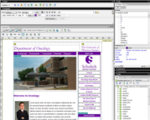


WHAT IS CSS?
You can store CSS styles in two ways:
Within each webpage (embedded)
In an external style sheet and attach it to the webpage
Benefits:
Useful for maintaining site
Appearance through 1 file
Easier to implement design changes across entire website
Enhances site’s appearance
Consistent and uniform
Promotes professional look
Reuseablilty
You can apply style sheet to any webpage
More control of elements/tags
File Size
Reduces file size if attached rather than embedded

Slide 9

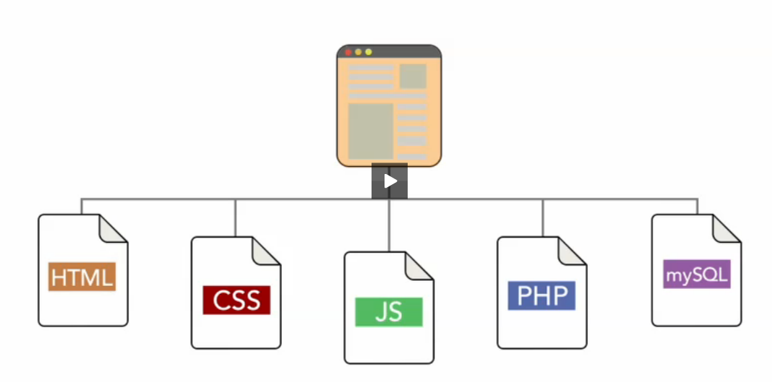
BENEFITS OF CSS?
Benefits: Presents highly modularized web designs
A Website can be controlled and constructed by five elements:
  HTML – controls document structure
  CSS – controls document look and feel – style/presenation
  Javascript – controls the behaviour within the client /browser
  PHP – server side languages control processing and business logic
  MySQL – controls database content
A website can use all of these elements or none or a few of them.
BUT as a minimum
.html is needed

Slide 10
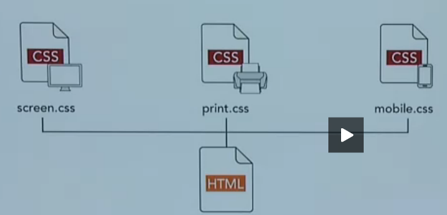
DEFINING STYLES FOR DIFFERENT MEDIA
Separating styles and structure allows for portability
Define different style for different types of media
Looks one way on desktop, and more optimized for printing or mobile devices
So you change the look on that device WITHOUT changing the content
(will look at this in another lecture)

Slide 11
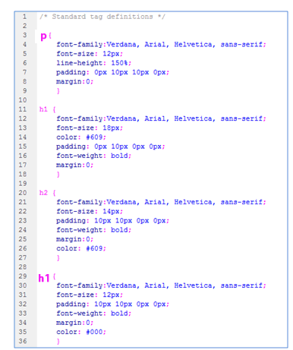
WHAT IS CSS?
CSS Order of Precedence:
Cascade refers to how files are
applied to pages:
Styles are applied in the order they are found
Embedded styles take priority only over external styles.
the styles in the lowest stylesheet overrides those in the higher stylesheets
For example: Order attached to this webpage
Stylesheet1 – h1, h2, p, img
Stylesheet2 - h2,ordered list
Stylesheet3 – h2, img

Slide 12
CSS CONCEPTS :
Starting to build a website without tables
Now build a website
.... the “Developer” way ...
Use CSS Styles
Using Tables
Using CSS Styles
1st table: 2 rows x 1 col
2nd table: 2 rows x 2 col
Identifying box elements and attributes
using Div IDs and Classes
Notes:
16px may look great on a desktop monitor, but on a mobile device 16px is huge
If we use 1em , telling device to set font to 100% of its default font size which is one size on the desktop and another size on a mobile device

Slide 13
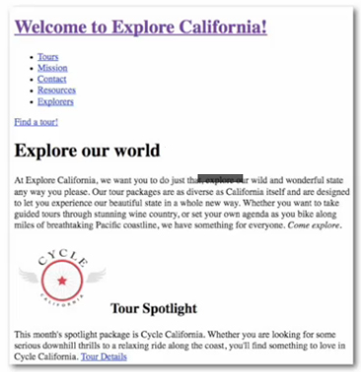
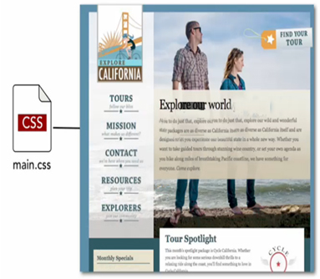
THE BOX MODEL – and – YOUR WEBSITE
Before authors were allowed to control html pages through Cascading style sheets, browsers had to have a way to display HTML content visually.
Manufacturers agreed early on how to display specific elements...
How to represent a link; How to represent a heading, an image etc.
All browser default style sheets render a page similar to this
With a style sheet you are overriding this default style with styles of what you want it to look like

Slide 14
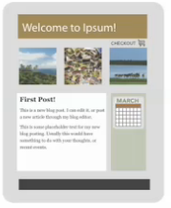
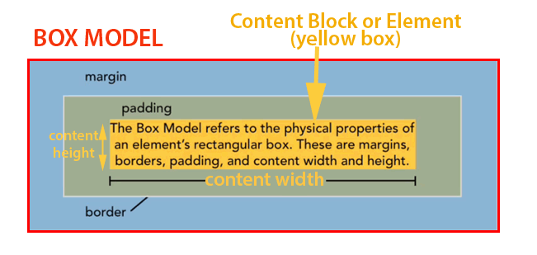
CSS CONCEPTS :
Starting to build a website with styles
The premises of creating a website
is using the Box model:
So what is an Element?
It could be a
table cell
a heading
Image
structured list
Link
text etc...
Every HTML element on your webpage is considered to be a rectangular box.
Box model properties:
Box Model describes the 4 physical properties around elements.
  Margin
  Border
  Padding
  Content Block/Element (yellow) will contain text or image
  -defined by height and width)
Notes:
EXAM

Slide 15
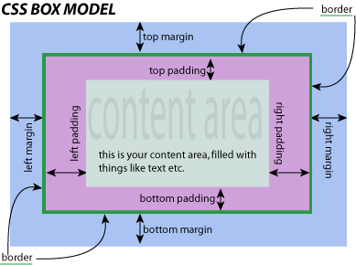
THE BOX MODEL – and – YOUR WEBSITE
Margins: The space around an element
Border: can describe width, style, color, and a line to the top, right, bottom, left
Padding: space between the content block and the border
Margin: space between 2 elements. It is invisible and has no background color and will not obstruct elements behind it.
Notes:
EXAM

Slide 16

THE BOX MODEL – and – YOUR WEBSITE
box {
width: 200px;
height:100px;
border: 10px solid #99c;
padding: 20px;
margin: 20px;
}
border=10px
Width(200px) +Padding(20px+20px)
=light purple shade= 240px
right margin
=20px
left margin
=20px
Calculating OVERALL Box Model: (Element Width = Content Block)
Box width = 260px = (200+20+20+10+10)
= Content width + padding-left + padding-right + border-left + border-right
Box height = 160px = (100+20+20+10+10)
= Content height + padding-top + padding-bottom + border-top + border-bottom
IMPORTANT
Notice that Margins is not included in the overall calculation because it designates the space between 2 elements
Notes:
EXAM – won’t be asked to write code

Slide 17

CSS CONCEPTS :
Starting to build a website with styles
The premises of creating a website is using the Box model:
Benefits of CSS:
Lay things out
Provide each box element with attributes →control look
Assign attributes (rules) to a box element
For example:
<header>
  Width=900px
  Height=200px
  Padding= 0px
  Border=2px
  Margin=0px
  And there is so much more to specify
<nav>
  Width=900px
  Height=80px
  Padding= 10px
  Border=1px
  Margin=0px

Slide 18
CSS CONCEPTS :
Starting to build a website with styles
Box model:
Code using CSS Styles
Each box element is created using a Div ID or a Class
Classes and ID's control the styling and layout
Identifying box elements called Div ID
  #header
  #nav
  #article
  #section
  #aside
  #footer
Identifying box elements called Classes
  .header
  .nav
  .article
  .section
  .aside
  .footer
So what’s the difference between using a
Div ID or a Class?
Let’s explore
Notes:
16px may look great on a desktop monitor, but on a mobile device 16px is huge
If we use 1em , telling device to set font to 100% of its default font size which is one size on the desktop and another size on a mobile device

Slide 19
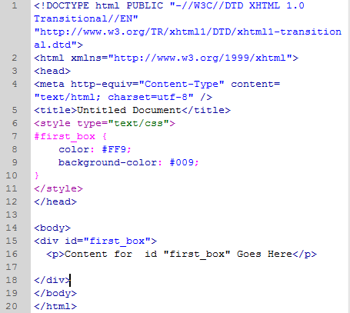
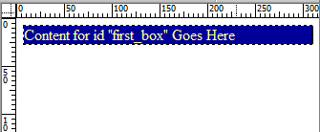
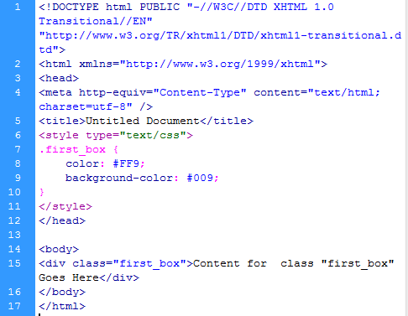
Simple Case: To generate this box model
Different syntax
Between style tags
# first_box ( if div ID)
.first_box (if class)
Between body tags
div id=“first_box”
div class=“first_box”
Creating box element called
div ID #first_box
and assigning attributes
Call to the element
(Div ID) between <body> tags
But still
when should you use one over the other?
Let’s explore
Creating box element called class .first_box and assigning attributes
Call to the element
(class) between <body> tags
Notes:
16px may look great on a desktop monitor, but on a mobile device 16px is huge
If we use 1em , telling device to set font to 100% of its default font size which is one size on the desktop and another size on a mobile device

Slide 20
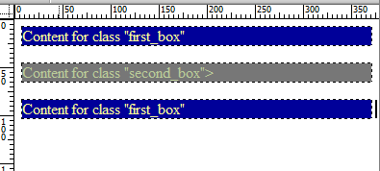
CSS CONCEPTS :
Div Ids and Classes
So what’s the difference between using a div ID or a class?
Div ID used for:
  Used to identify sections of a webpage
  → unique within a webpage
  Can only be used ONCE in a webpage
  → used for identifying the section
  Example: One header ID, one nav id, one aside ID etc.
Classes used for:
  Used to identify sections of a webpage
  → repetitive within a webpage
  Can be used MORE THAN ONCE in a webpage
  #header
  #nav
  #article
  #section
  #aside
  #footer
Notes:
16px may look great on a desktop monitor, but on a mobile device 16px is huge
If we use 1em , telling device to set font to 100% of its default font size which is one size on the desktop and another size on a mobile device

Slide 21
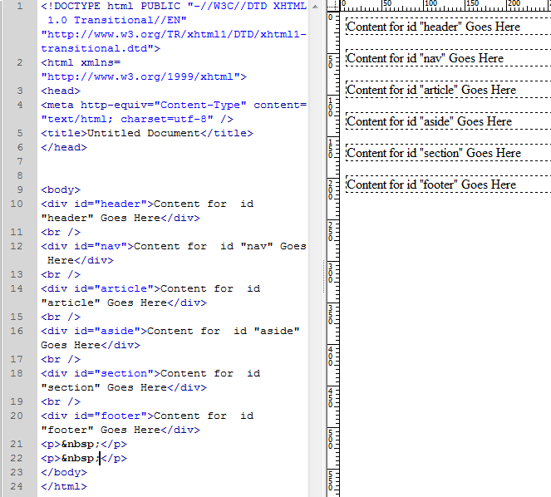
CSS CONCEPTS :
Div Ids
In this code:
  The Div ID code has been created in the body
  But we haven’t given it any attributes yet to create the look nothing in the head section)
  LEARN IN UPCOMING SLIDES how to create the effects
Notes:
16px may look great on a desktop monitor, but on a mobile device 16px is huge
If we use 1em , telling device to set font to 100% of its default font size which is one size on the desktop and another size on a mobile device

Slide 22
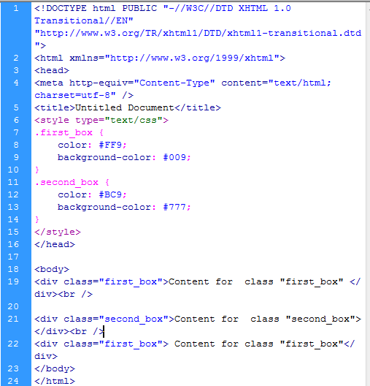
CSS CONCEPTS :
CLASSES
Making 2 boxes using Classes
with different attributes
Flexibility:
Class is controlled by style attributes
.first_box or .second_box
So you have control to style each box
Notes:
16px may look great on a desktop monitor, but on a mobile device 16px is huge
If we use 1em , telling device to set font to 100% of its default font size which is one size on the desktop and another size on a mobile device

Slide 23
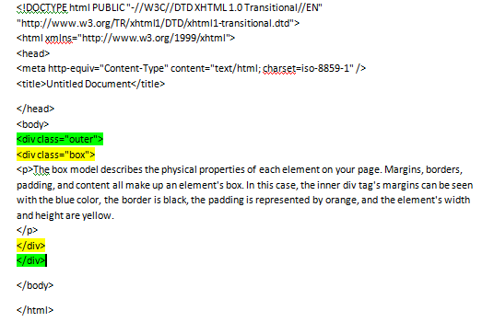
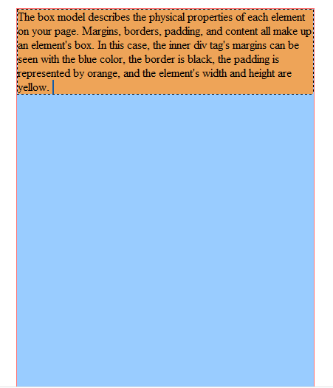
STARTING TO BUILD THE WEBSITE
Understanding how to work with sections
We want to create this layout with styles rather than tables
We need to define what these two boxes will look like
We need to assign atributes to them

Slide 24
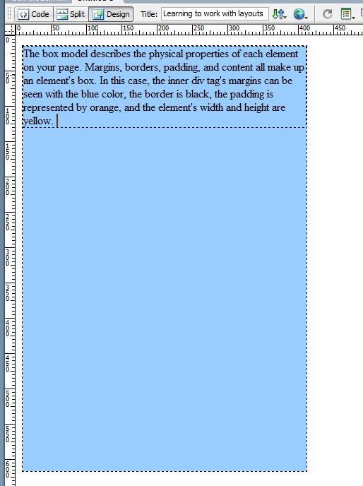
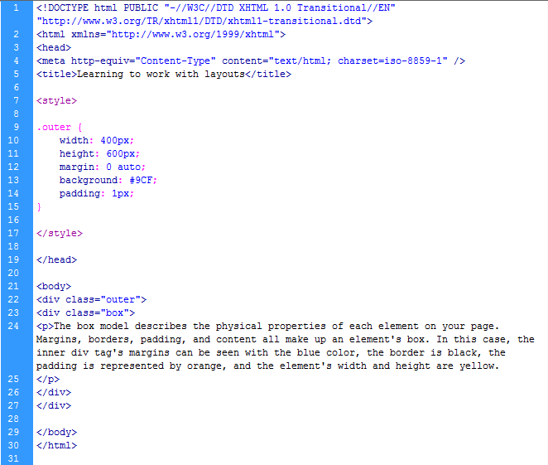
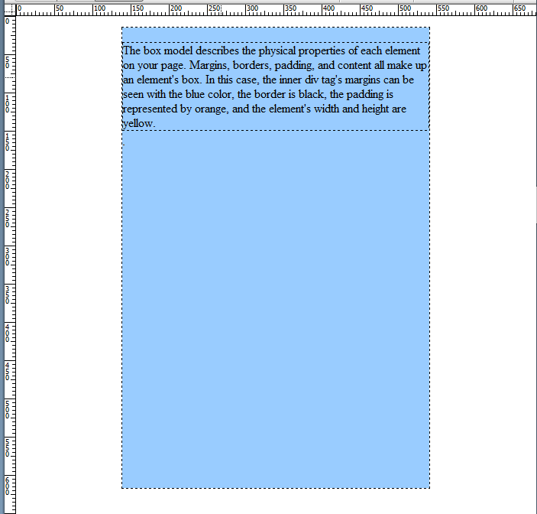
STARTING TO BUILD THE WEBSITE
We created a style for class “outer”
Without the margin: 0 auto;
Giving class “outer”
characteristics
With the margin: 0 auto;
“auto” Tells browser to split up the available space between the left and right edges which means center it on the page
Notes:
EXAM

Slide 25
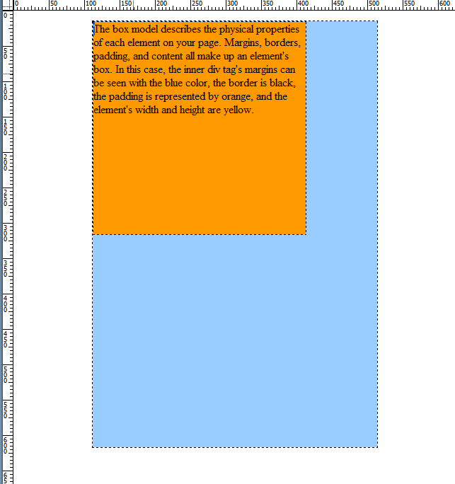
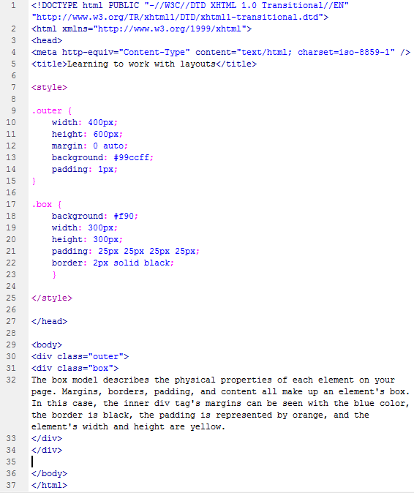
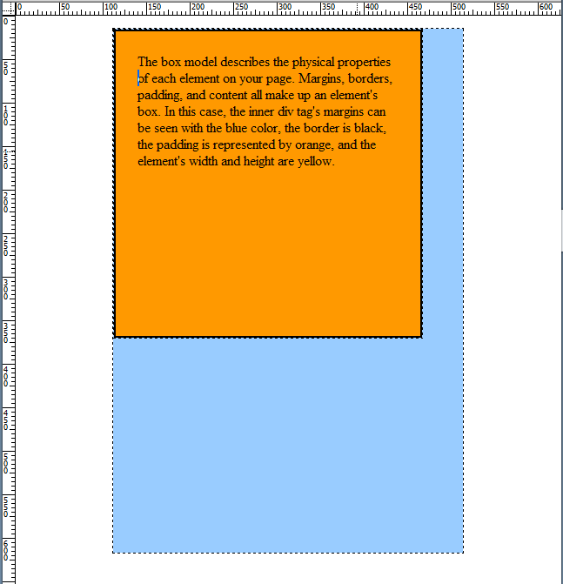
STARTING TO BUILD THE WEBSITE
We created a style for class “box” & “outer”
300 px
300 px
No padding or border
ADDED to our previous slide
Giving class “box”
characteristics
padding 25px
(all around)
border 2px
solid black
Notes:
EXAM
Padding TOP RIGHT BOTTOM LEFT

Slide 26
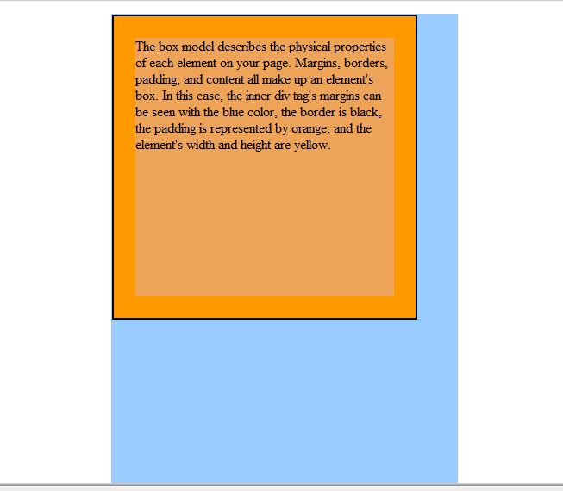
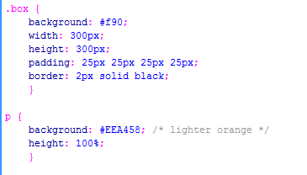
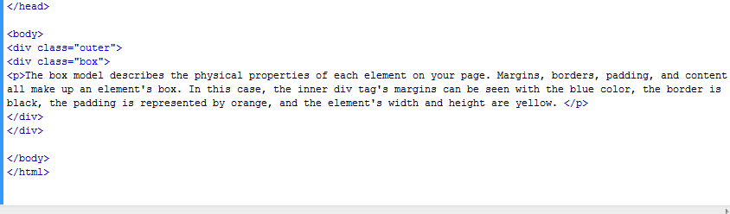
STARTING TO BUILD THE WEBSITE
To the class box we added:
p (which is paragraph)
border 2px
solid black
if it doesn’t have a defined width and height just occupy the out the element it is in

Slide 27
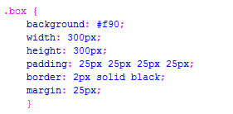
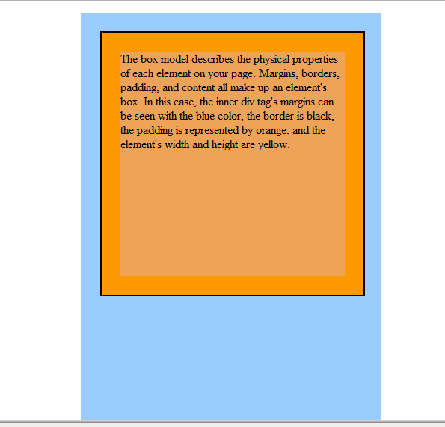
STARTING TO BUILD THE WEBSITE
To the class box we added Margins
Tells it to control the spacing from one element to another
(in this case the separation of the box from the outer box)
After:
Margin: 25px all around it
Before

Slide 28
STARTING TO BUILD THE WEBSITE
Calculating box element dimensions
The horizontal width of class “box” is cumulative..
  Total Width of “box” is:
  Width = 300px
  Padding (horizontal on both sides) = 25px + 25px = 50px
  Border on both sides = 2px + 2px = 4px
  Margin on both sides = 25px + 25px = 50px
  GRAND TOTAL = 404 px
  It is over the “outer” width of 400 .. But it still fits.
  Browser ignores certain margin values that would overlap... And throws it out!
PROBLEM:
Our “outer” box is a width of 400px
so why did it not go over?
404px
“box” width
Notes:
CSS Page Layouts – james Williamson

Slide 29
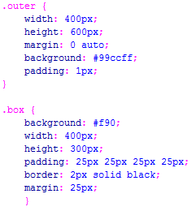
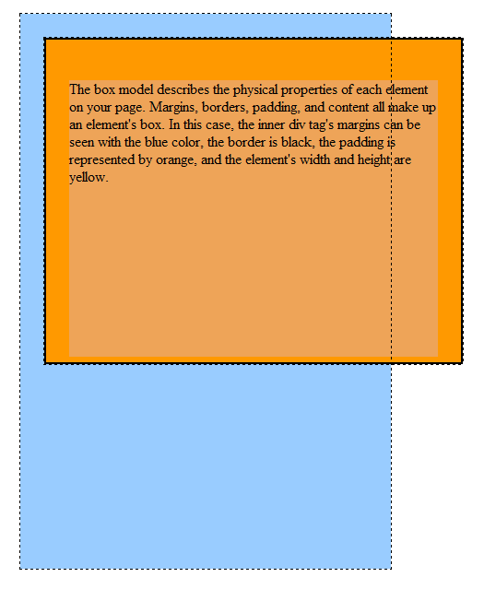
STARTING TO BUILD THE WEBSITE
Calculating box element dimensions
2 measurements:
Container block (Margins) and Content block
Content block: (“box”)
Border, padding, width = 4px + 50px + 400px = 454px
Container block: (“box”) margins = 25px+25px = 50px
GRAND TOTAL = 504px
Dimension of outer = 400px + 2px = 402px
Thus spills out
What if the content block (box)
exceeds the width of outer
It spills over and overlaps
And it will affect whatever else may be around it.
There is an overflow value you can put on “outer”
overflow: hidden (crops it off)
overflow: auto (add a scroll at the bottom)
But try not to use it.
RULE:
Plan your dimensions of you inner and outer elements
504px
box width

Slide 30
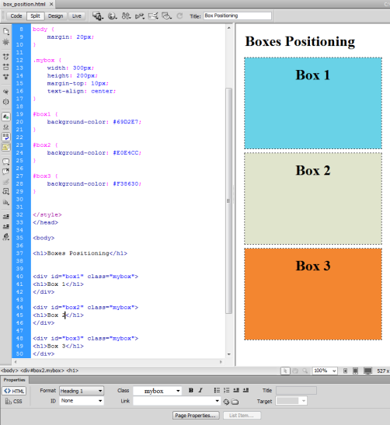
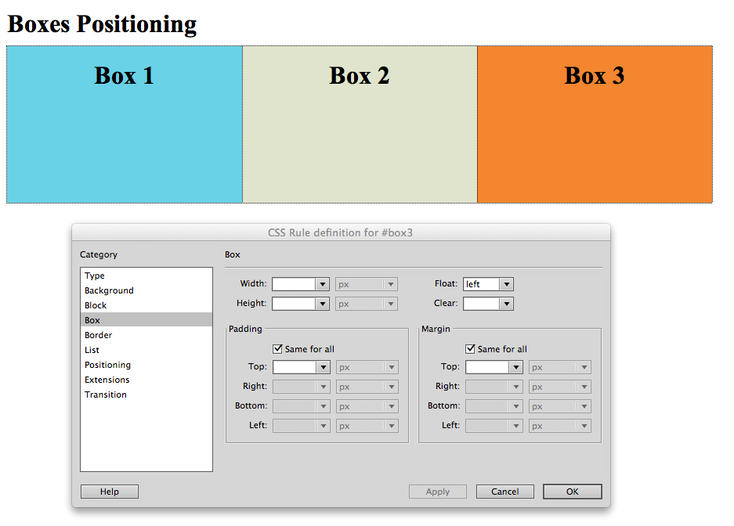
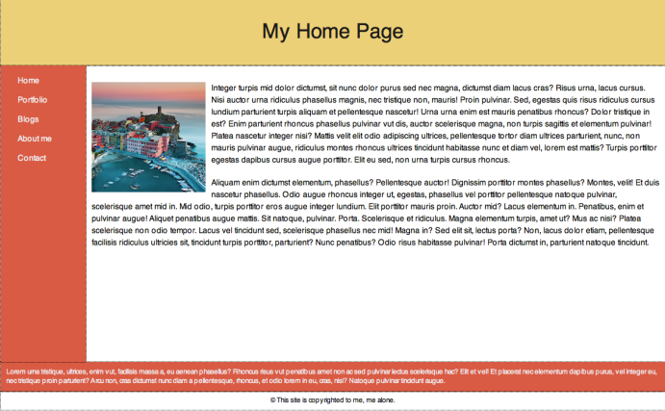
STARTING TO BUILD THE WEBSITE
In the Lab this week:
You are going to learn how to
Create a website using the box model
Positioning in your boxes
Use Dreamweaver menu and commands (no coding)

